Slide 1



DB Locked 問題診斷及解除
研發部 H610
馮鼎權
Tim Feng
May 5, 2020

Slide 2
DB Locked 問題診斷及解除
DB Locked測試前置作業
Single DB on Windows (單機Windeows)
Single DB on Linux (單機Linux)
RAC DB on Linux (雙主機)
使用EM 查看DB Locked情況
Kill Session說明

Slide 3

DB Locked前置作業
-建Table&塞資料

Slide 4
DB Locked 前置作業-建user &塞資料
DB_Locked 測試前置作業-Create User & Create Table &Insert Data
[oracle@rac1 ~]$ sqlplus / as sysdba;
SQL> CREATE user app identified by app default tablespace USERS temporary tablespace TEMP;
User created.
SQL> GRANT CONNECT, RESOURCE,DBA,UNLIMITED TABLESPACE TO APP;
Grant succeeded.
SQL> conn app/app
Connected.
SQL> create table book (id number,
bookname varchar2(30));
Table created.
SQL> insert into book values(1,'Linux');
1 row created.
SQL> insert into book values(2,'Oracle');
1 row created.
SQL> commit;
Commit complete.

Slide 5
DB Locked在單機Windows環境下

Slide 6
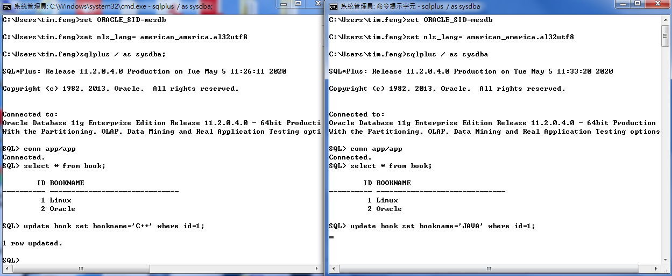
DB Locked 在單機Windows環境下
查詢該Session 的SPID方法;
SQL> select spid from v$process
where addr=(select paddr from v$session where sid=(select distinct sid from v$mystat));
DB_Lock鎖定情況:Session1 & Session2 (Session1,2都尚未Commit)
(Session2→ Hang)

Slide 7
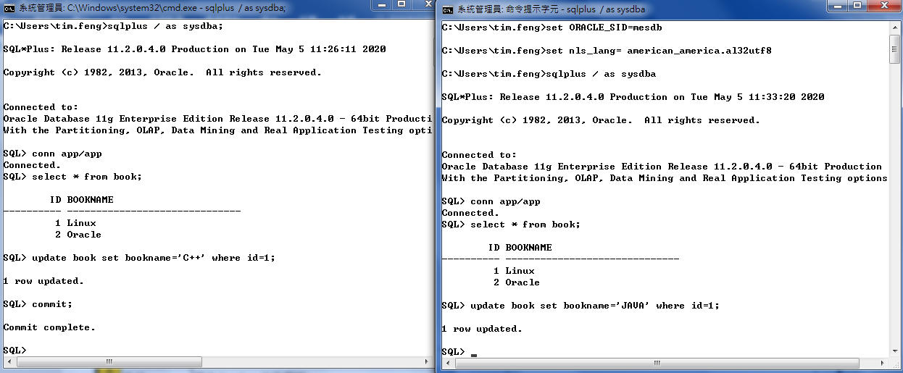
DB Locked 在單機Windows環境下
查詢該Session 的SPID方法;
SQL> select spid from v$process
where addr=(select paddr from v$session where sid=(select distinct sid from v$mystat));
DB_Lock鎖定情況:Session1 & Session2 (Session1→Commit)

Slide 8
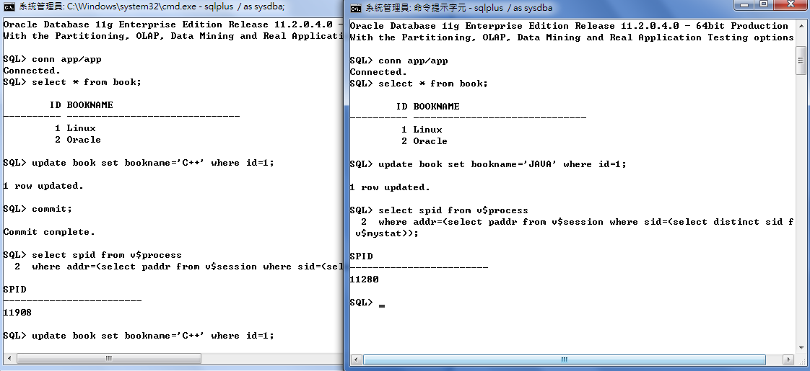
DB Locked 在單機Windows環境下
查詢該Session 的SPID方法;
SQL> select spid from v$process
where addr=(select paddr from v$session where sid=(select distinct sid from v$mystat));
DB_Lock鎖定情況:Session1 & Session2 (Session2→Hang)

Slide 9
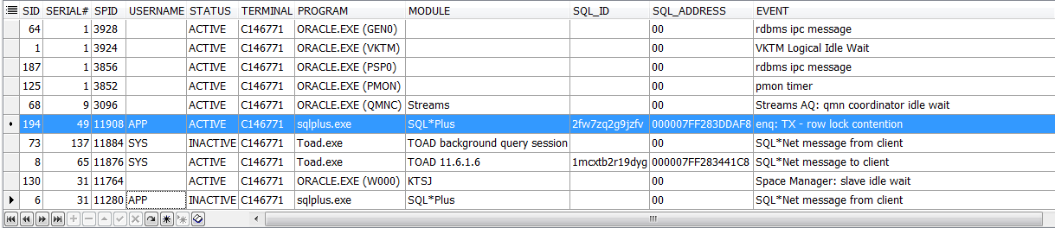
DB Locked 在單機Windows環境下
DB_Lock鎖定情況:Session1 & Session2 (Session2→Hang)
查詢該Session 的DB Lock方法;
SELECT se.sid,se.serial#,pr.SPID,se.username,se.status,se.terminal,se.program,se.MODULE,se.SQL_ID,se.sql_address,st.event,st.p1text,si.physical_reads,si.block_changes
FROM v$session se,v$session_wait st,v$sess_io si,v$process pr
WHERE st.sid=se.sid AND st.sid=si.sid AND se.PADDR=pr.ADDR ORDER BY SID DESC;

Slide 10

DB Locked 在單機Windows環境下
DB_Lock鎖定情況:Session1 & Session2 (Session2→Hang)
查詢該Session 的DB Lock方法;
SELECT S.SID, S.SERIAL#, S.USERNAME,s.status ,S.OSUSER , S.MACHINE, S.PROGRAM , P.SPID
FROM V$SESSION S , V$PROCESS P
WHERE S.PADDR = P.ADDR AND S.TYPE !='BACKGROUND' AND S.USERNAME !='SYS' and s.username !='SYSTEM';

Slide 11

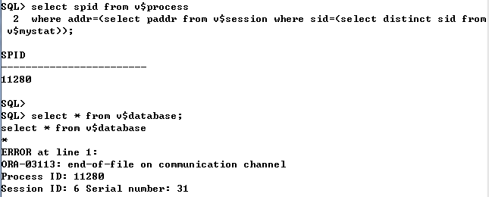
DB Locked 在單機Windows環境下
DB_Lock鎖定情況:Kill Session & Kill Process & TASKKILL
1). kill session
一般情況下kill session 指令並不會真正的刪除session, 而是要求session 自行刪除,但在某些情況session並不會自行刪除,例如session 正在rollback transaction,此時可以透過immediate參數來強制刪除session
SQL> ALTER SYSTEM KILL SESSION 'sid,serial#' IMMEDIATE;
2).Kill O.S. process
kill session 之後,有時process 會殘留在O.S.上, 此時就需要透過O.S.的指令來刪除殘留的porcess
Windows
C:> orakill ORACLE_SID spid
Unix/Linux
% kill spid
% kill -9 spid

Slide 12
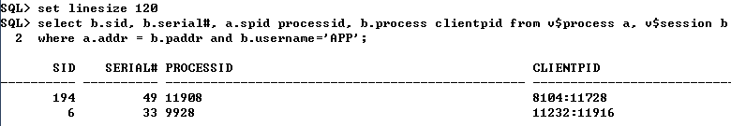

DB Locked 在單機Windows環境下
DB_Lock鎖定情況:使用Dos Command
3). 使用TASKKILL PID
select b.sid, b.serial#, a.spid processid, b.process clientpid from v$process a, v$session b
where a.addr = b.paddr and b.username='APP';
SELECT S.SID, S.SERIAL#, S.USERNAME,s.status ,S.OSUSER , S.MACHINE, S.PROGRAM , P.SPID
FROM V$SESSION S , V$PROCESS P
WHERE S.PADDR = P.ADDR AND S.TYPE !='BACKGROUND' AND S.USERNAME !='SYS';
C:\Users\tim.feng>TASKKILL /F /PID 11232
成功: 處理程序 PID 11232 已經終止了。

Slide 13
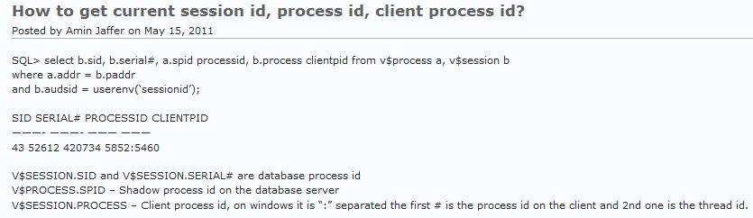
DB Locked 在單機Windows環境下
DB_Lock鎖定情況:使用TASKKILL PID說明
How to get current session id, process id, client process id?
Posted by Amin Jaffer on May 15, 2011
SQL> set linesize 120
SQL> select b.sid, b.serial#, a.spid processid, b.process clientpid
from v$process a, v$session b
where a.addr = b.paddr
and b.audsid = userenv('sessionid');

Slide 14
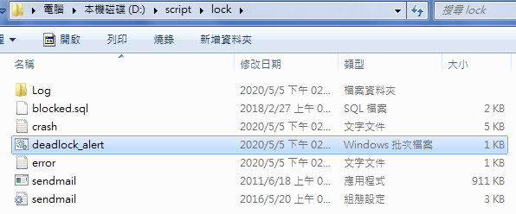
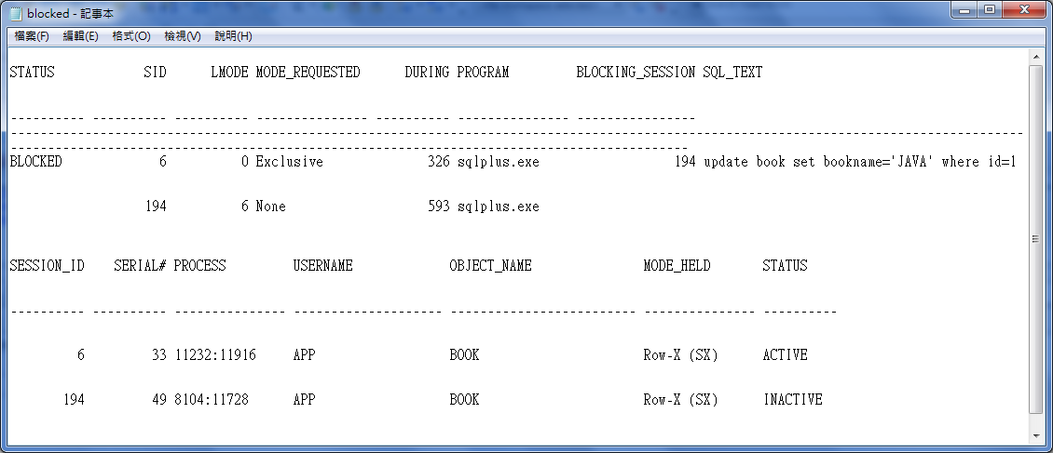
DB Locked 在單機Windows環境下
DB_Lock鎖定情況:使用Batch Script 偵測
定期20~30分鐘執行batch script ,如果有DB Locked會產生Log並寄送mail

Slide 15
Single DB Locked 在Linux環境下

Slide 16
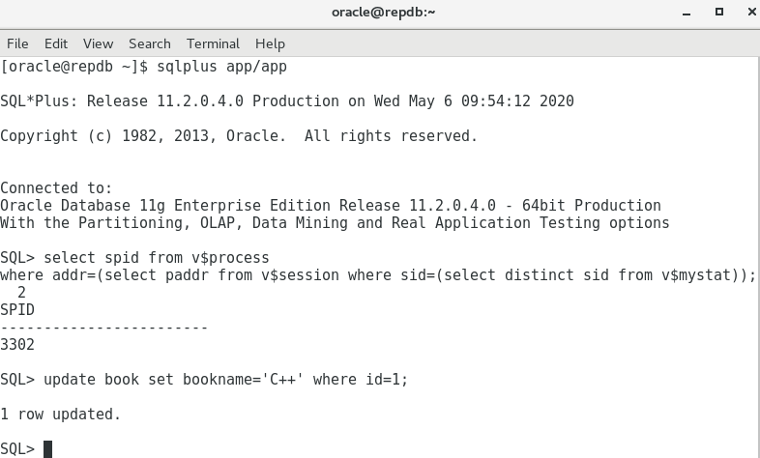
Single DB Locked 在Linux環境下
查詢該Session 的SPID方法;
SQL> select spid from v$process
where addr=(select paddr from v$session where sid=(select distinct sid from v$mystat));
DB_Lock鎖定情況:Session1 & Session2 (Session1,2都尚未Commit)

Slide 17
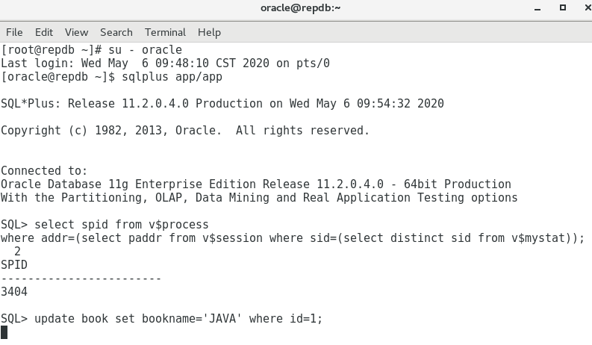
Single DB Locked 在Linux環境下
查詢該Session 的SPID方法;
SQL> select spid from v$process
where addr=(select paddr from v$session where sid=(select distinct sid from v$mystat));
DB_Lock鎖定情況:Session1 & Session2 (Session2→ Hang)

Slide 18
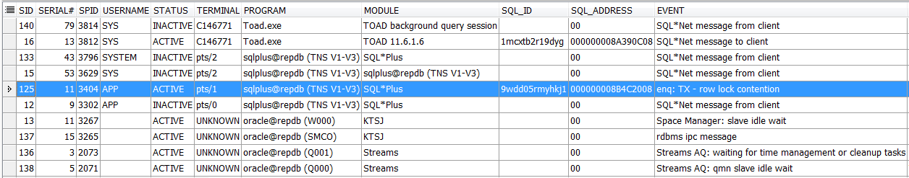
Single DB Locked 在Linux環境下
DB_Lock鎖定情況:Session1 & Session2 (Session2→Hang)
查詢該Session 的DB Lock方法;
SELECT se.sid,se.serial#,pr.SPID,se.username,se.status,se.terminal,se.program,se.MODULE,se.SQL_ID,se.sql_address,st.event,st.p1text,si.physical_reads,si.block_changes
FROM v$session se,v$session_wait st,v$sess_io si,v$process pr
WHERE st.sid=se.sid AND st.sid=si.sid AND se.PADDR=pr.ADDR ORDER BY SID DESC;

Slide 19

Single DB Locked 在Linux環境下
DB_Lock鎖定情況:Session1 & Session2 (Session2→Hang)
查詢該Session 的DB Lock方法;
SELECT S.SID, S.SERIAL#, S.USERNAME,s.status ,S.OSUSER , S.MACHINE, S.PROGRAM , P.SPID
FROM V$SESSION S , V$PROCESS P
WHERE S.PADDR = P.ADDR AND S.TYPE !='BACKGROUND' AND S.USERNAME !='SYS' and s.username !='SYSTEM';

Slide 20
Single DB Locked 在Linux環境下
DB_Lock鎖定情況:Session1 & Session2 (Session2→Hang)
SELECT *
FROM (SELECT 'Current Process: '||osid W_PROC, 'SID '||i.instance_name INSTANCE,
'INST #: '||instance INST,'Blocking Process: '||decode(blocker_osid,null,'<none>',blocker_osid)||
' from Instance '||blocker_instance BLOCKER_PROC,'Number of waiters: '||num_waiters waiters,
'Wait Event: ' ||wait_event_text wait_event, 'P1: '||p1 p1, 'P2: '||p2 p2, 'P3: '||p3 p3,
'Seconds in Wait: '||in_wait_secs Seconds, 'Seconds Since Last Wait: '||time_since_last_wait_secs sincelw,
'Wait Chain: '||chain_id ||': '||chain_signature chain_signature,'Blocking Wait Chain: '||decode(blocker_chain_id,null,
'<none>',blocker_chain_id) blocker_chain
FROM v$wait_chains wc,
v$instance i
WHERE wc.instance = i.instance_number (+)
AND ( num_waiters > 0
OR ( blocker_osid IS NOT NULL
AND in_wait_secs > 10 ) )
ORDER BY chain_id,
num_waiters DESC)
WHERE ROWNUM < 101;

Slide 21
Single DB Locked 在Linux環境下
DB_Lock鎖定情況:Kill Session & Kill Process
1.Kill Session Syntax
一般環境下kill session syntax如下
SQL> ALTER SYSTEM KILL SESSION 'sid,serial#';
SQL> ALTER SYSTEM KILL SESSION '12,9';
System altered.
SQL> select * from book;
select * from book
*
ERROR at line 1:
ORA-00028: your session has been killed
在RAC的環境下kill session 要加上INST_ID
ALTER SYSTEM KILL SESSION 'sid,serial#,@inst_id';
SQL> ALTER SYSTEM KILL SESSION '151,43,@1';
2).Kill Process Syntax
oracle@repdb ~]$ kill -9 3302

Slide 22
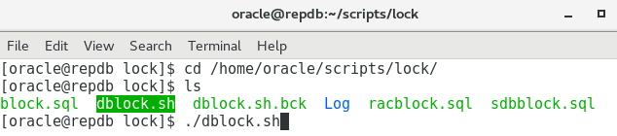
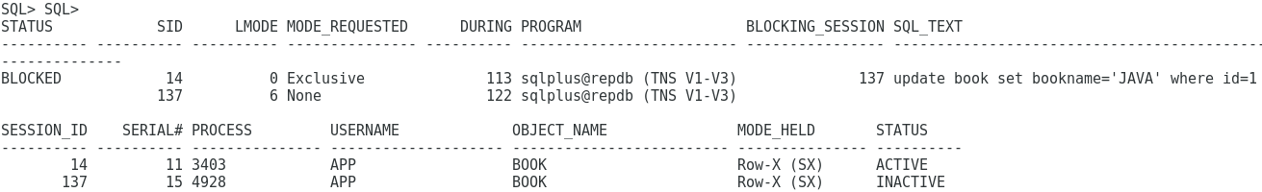
Single DB Locked 在Linux環境下
DB_Lock鎖定情況:使用Shell Script 偵測
定期20~30分鐘執行Shell script ,如果有DB Locked會產生Log並寄送mail

Slide 23
RAC DB Locked在Linux環境下

Slide 24
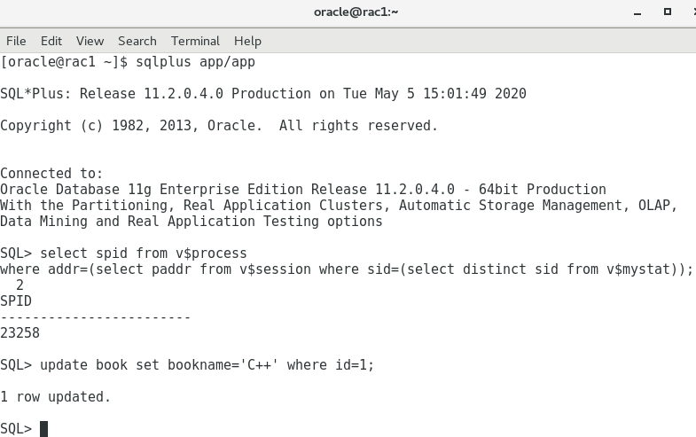
RAC DB Locked 在Linux環境下
查詢該Session 的SPID方法;
SQL> select spid from v$process
where addr=(select paddr from v$session where sid=(select distinct sid from v$mystat));
DB_Lock鎖定情況:Session1 & Session2 (Session1,2都尚未Commit)

Slide 25
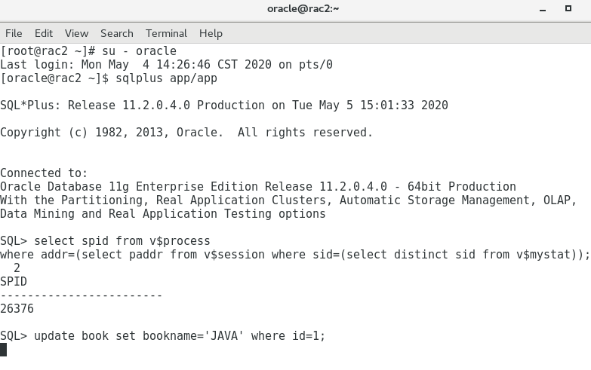
RAC DB Locked 在Linux環境下
查詢該Session 的SPID方法;
SQL> select spid from v$process
where addr=(select paddr from v$session where sid=(select distinct sid from v$mystat));
DB_Lock鎖定情況:Session1 & Session2 (Session2→ Hang)

Slide 26
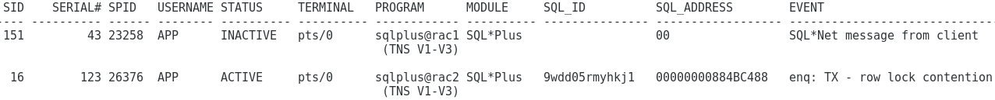
RAC DB Locked 在Linux環境下
DB_Lock鎖定情況:Session1 & Session2 (Session1→Hang)
查詢該Session 的DB Lock方法;
set linesize 165
col spid format a6
col username format a8
col status format a10
col terminal format a10
col program format a12
col MODULE format a10
col SQL_ID format a15
col SQL_ADDRESS format a18
col event format a30
SELECT se.sid,se.serial#,pr.SPID,se.username,se.status,se.terminal,se.program,se.MODULE,se.SQL_ID,se.sql_address,st.event
FROM gv$session se,gv$session_wait st, gv$process pr
WHERE st.sid=se.sid AND se.PADDR=pr.ADDR and se.inst_id=pr.inst_id and se.USERNAME != 'SYS' ORDER BY SID DESC;

Slide 27
RAC DB Locked 在Linux環境下
DB_Lock鎖定情況:Session1 & Session2 (Session1→Hang)
查詢該Session 的DB Lock方法;
SELECT s.inst_id,
s.sid,
s.serial#,
--s.sql_id,
p.spid,
s.status,
s.username,
s.program
FROM gv$session s
JOIN gv$process p ON p.addr = s.paddr AND p.inst_id = s.inst_id
WHERE s.type != 'BACKGROUND' and s.USERNAME != 'SYS';

Slide 28
RAC DB Locked 在Linux環境下
DB_Lock鎖定情況:Session1 & Session2 (Session1→Hang)
SELECT *
FROM (SELECT 'Current Process: '||osid W_PROC, 'SID '||i.instance_name INSTANCE,
'INST #: '||instance INST,'Blocking Process: '||decode(blocker_osid,null,'<none>',blocker_osid)||
' from Instance '||blocker_instance BLOCKER_PROC,'Number of waiters: '||num_waiters waiters,
'Wait Event: ' ||wait_event_text wait_event, 'P1: '||p1 p1, 'P2: '||p2 p2, 'P3: '||p3 p3,
'Seconds in Wait: '||in_wait_secs Seconds, 'Seconds Since Last Wait: '||time_since_last_wait_secs sincelw,
'Wait Chain: '||chain_id ||': '||chain_signature chain_signature,'Blocking Wait Chain: '||decode(blocker_chain_id,null,
'<none>',blocker_chain_id) blocker_chain
FROM v$wait_chains wc,
v$instance i
WHERE wc.instance = i.instance_number (+)
AND ( num_waiters > 0
OR ( blocker_osid IS NOT NULL
AND in_wait_secs > 10 ) )
ORDER BY chain_id,
num_waiters DESC)
WHERE ROWNUM < 101;

Slide 29
RAC DB Locked 在Linux環境下
DB_Lock鎖定情況:Kill Session & Kill Process
1.Kill Session Syntax
一般環境下kill session syntax如下
SQL> ALTER SYSTEM KILL SESSION 'sid,serial#';
在RAC的環境下kill session 要加上INST_ID
ALTER SYSTEM KILL SESSION 'sid,serial#,@inst_id';
SQL> ALTER SYSTEM KILL SESSION '151,43,@1';
System altered.
SQL> select * from book;
select * from book
*
ERROR at line 1:
ORA-00028: your session has been killed
2).Kill Process Syntax
[oracle@rac2 ~]$ kill -9 23258

Slide 30
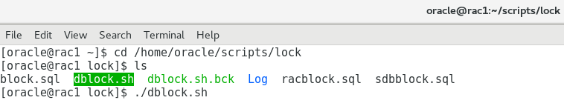
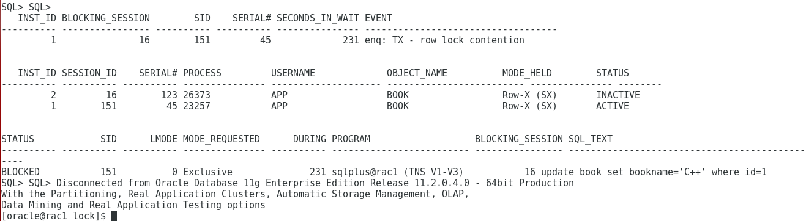
RAC DB Locked 在Linux環境下
DB_Lock鎖定情況:使用Shell Script 偵測
定期20~30分鐘執行Shell script ,如果有DB Locked會產生Log並寄送mail

Slide 31
DB Locked使用EM查看

Slide 32
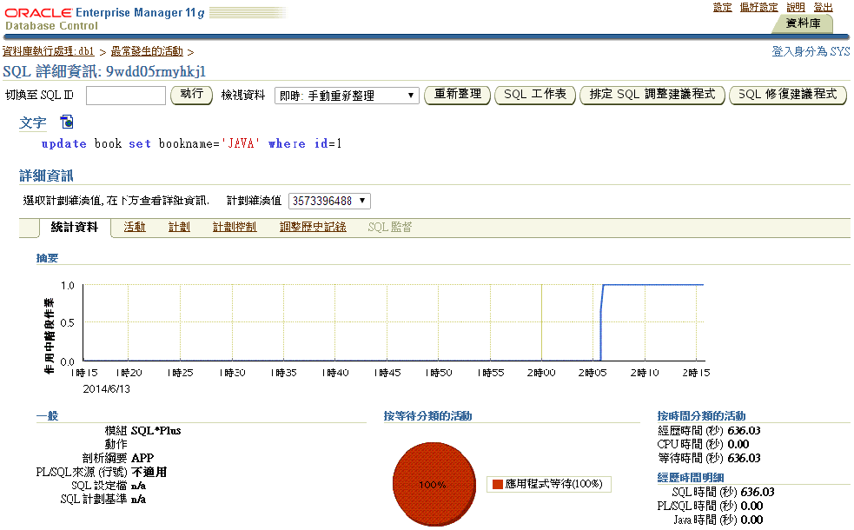
DB Locked 使用EM 方式查看
使用Enterprise Management-EM查看DB Lock情況

Slide 33
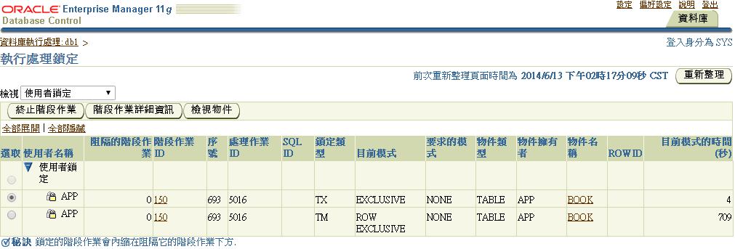
DB Locked 使用EM 方式查看
使用Enterprise Management-EM查看DB Lock情況
DB_Lock鎖定情況:Session1 & Session2 Locked查看情況)

Slide 34

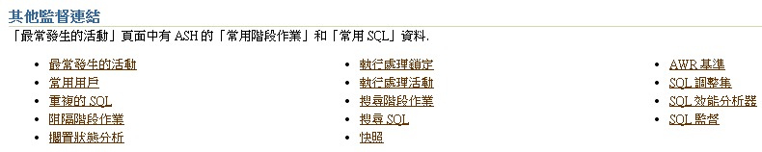
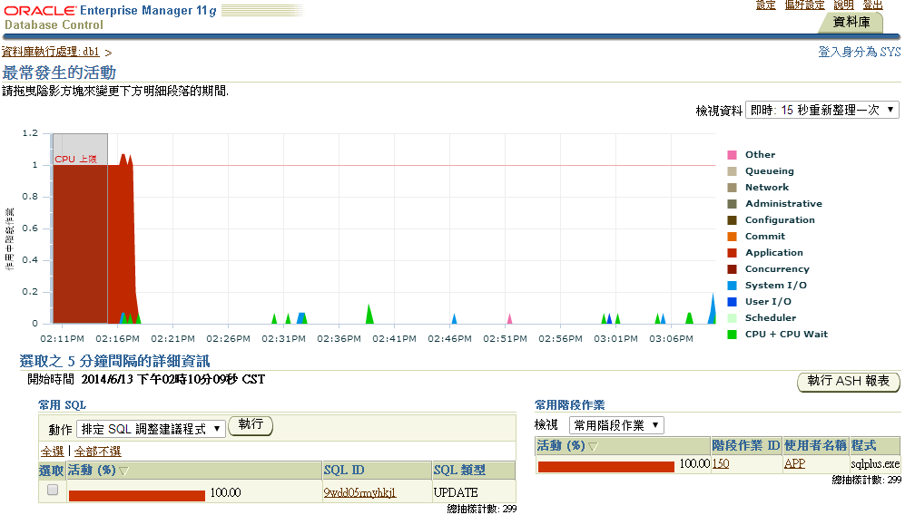
DB Locked 使用EM 方式查看
使用Enterprise Management-EM查看DB Lock情況
在Home頁面上點選→效能→其他監督連結→最常發生的活動→回朔DB Lock情況

Slide 35
Oracle資料庫Kill Session說明

Slide 36
Oracle資料庫Kill Session 說明
1.如果是RAC的環境,需要改查 gv$session
set linesize 165
col spid format a6
col username format a8
col status format a10
col terminal format a10
col program format a12
col MODULE format a10
col SQL_ID format a15
col SQL_ADDRESS format a18
col event format a30
SELECT se.sid,se.serial#,pr.SPID,se.username,se.status,se.terminal,se.program,se.MODULE,se.SQL_ID,se.sql_address,st.event
FROM gv$session se,gv$session_wait st, gv$process pr
WHERE st.sid=se.sid AND se.PADDR=pr.ADDR and se.inst_id=pr.inst_id and se.USERNAME != 'SYS' ORDER BY SID DESC;

Slide 37
Oracle資料庫Kill Session 說明
SELECT i.instance_name instance_name , RPAD(l.session_id,7) sid, RPAD(s.serial#,7) serial_number
, s.status session_status , l.oracle_username oracle_user, l.os_user_name os_username
, o.owner object_owner, o.object_name object_name, o.object_type object_type
,DECODE(L.LOCKED_MODE,
0, 'None', /* Mon Lock equivalent */
1, 'Null', /* NOT */
2, 'Row-SELECT (SS)', /* LIKE */
3, 'Row-X (SX)', /* R */
4, 'Share', /* SELECT */
5, 'SELECT/Row-X (SSX)', /* C */
6, 'Exclusive', /* X */
to_char(l.LOCKED_MODE)) mode_held
FROM
dba_objects o
, gv$session s
, gv$locked_object l
, gv$instance i
WHERE
i.inst_id = l.inst_id
AND l.inst_id = s.inst_id
AND l.session_id = s.sid
AND o.object_id = l.object_id
ORDER BY
l.session_id
/

Slide 38
Oracle資料庫Kill Session 說明
2. Kill Session Syntax
一般環境下kill session syntax如下
SQL> ALTER SYSTEM KILL SESSION 'sid,serial#';
在RAC的環境下kill session 要加上INST_ID
ALTER SYSTEM KILL SESSION 'sid,serial#,@inst_id';
一般情況下kill session 指令並不會真正的刪除session, 而是要求session 自行刪除,但在某些情況session並不會自行刪除,例如session 正在rollback transaction,此時可以透過immediate參數來強制刪除session
ALTER SYSTEM KILL SESSION 'sid,serial#' IMMEDIATE;
3. DISCONNECT SESSION Syntax
Disconnect session 和 kill ssession 的作用很類似,不同在於disconnect session 刪除server process
ALTER SYSTEM DISCONNECT SESSION 'sid,serial#' POST_TRANSACTION;
ALTER SYSTEM DISCONNECT SESSION 'sid,serial#' IMMEDIATE;
POST_TRANSACTION 參數會等待正在執行的transcation執行完畢
IMMEDIATE參數會強制結束server process

Slide 39
Oracle資料庫Kill Session 說明
4. Kill O.S. process
kill session 之後,有時process 會殘留在O.S.上, 這個時候就需要透過O.S.的指令來刪除殘留的porcess
Windows
C:> orakill ORACLE_SID spid
C> TASKKILL /F /PID XXX
Unix
% kill spid
Linux
% kill -9 spid

Slide 40

www.chromaate.com
let’s make a better world
Thank You!
Copyright©2016 Chroma ATE Inc.

